Slide 1
Microsoft Azure
Hybrid
Peter Kirchner Technical Evangelist Microsoft Deutschland GmbH

Slide 2



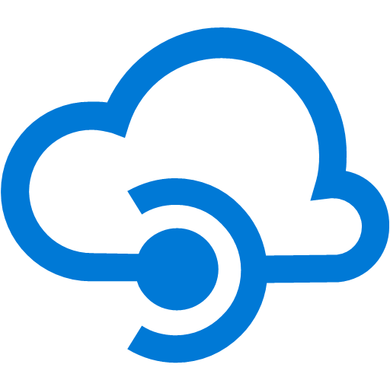
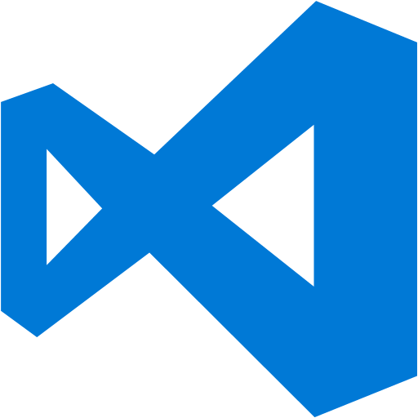
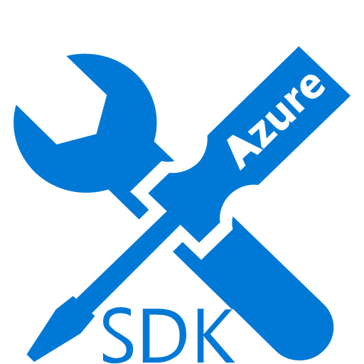
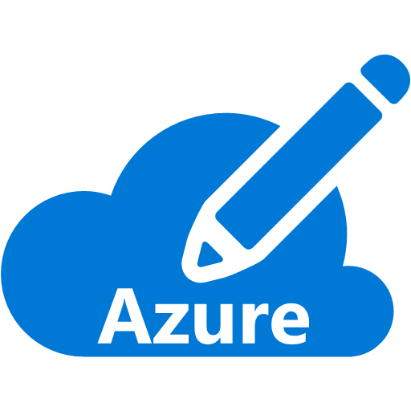

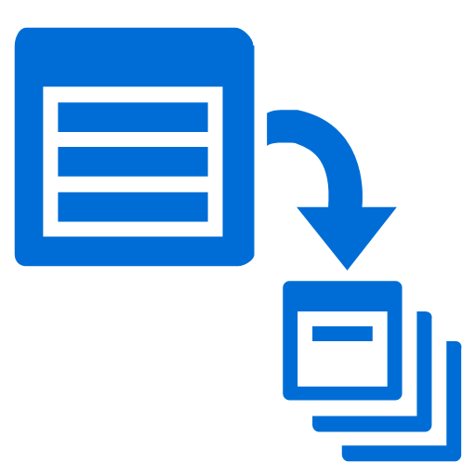

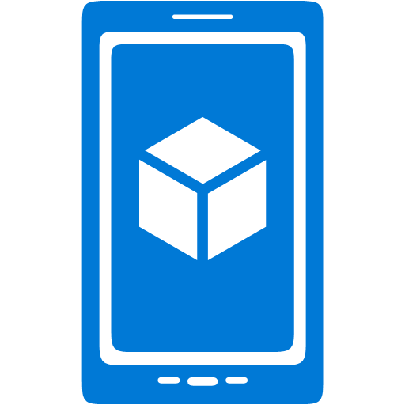







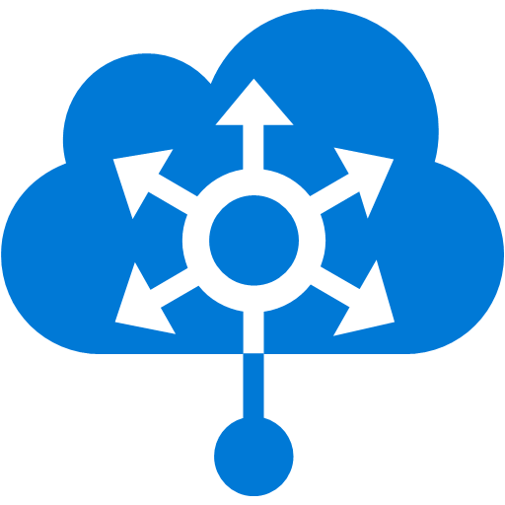



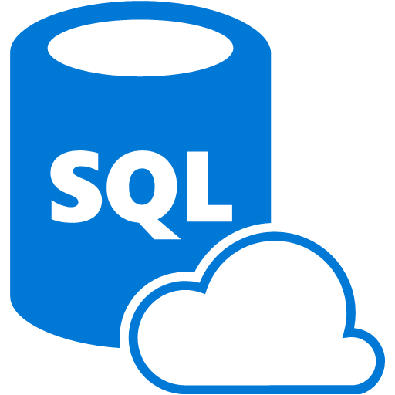







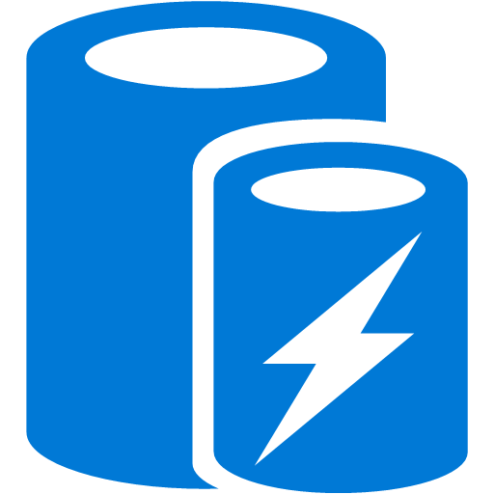
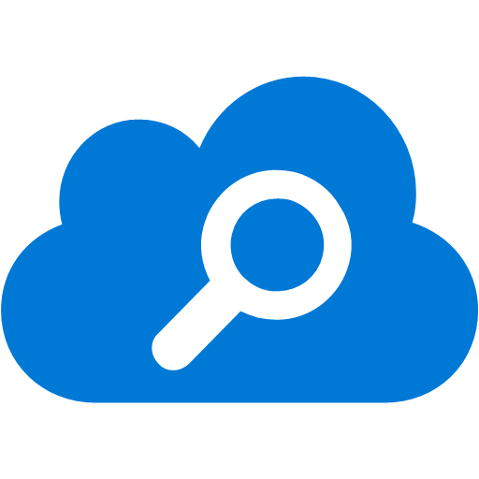
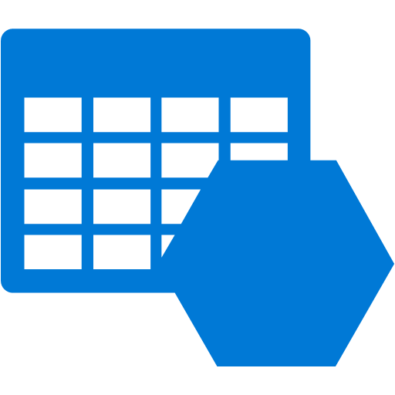




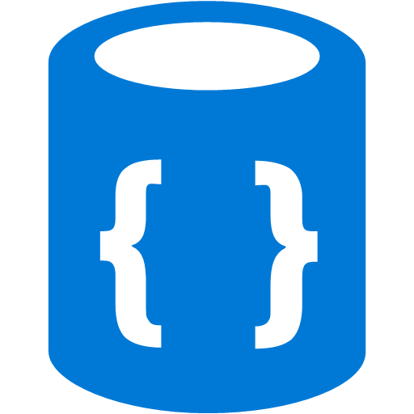
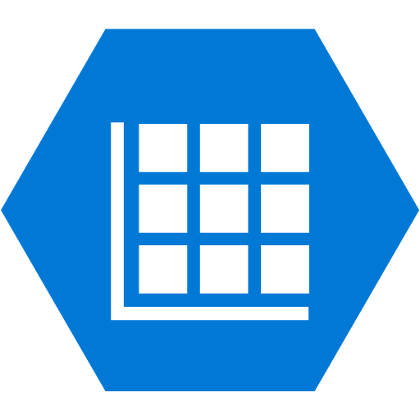


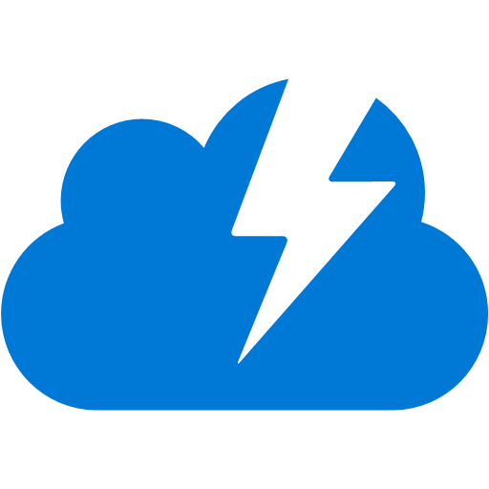

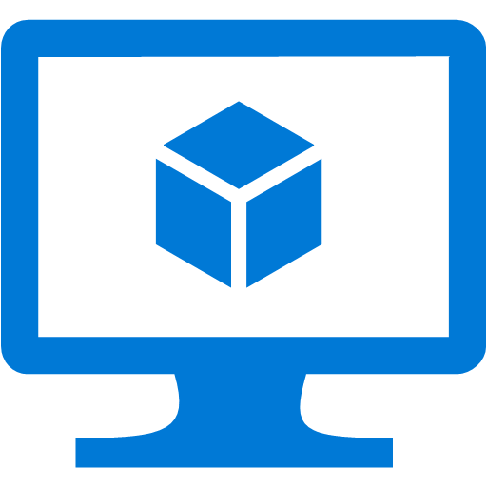
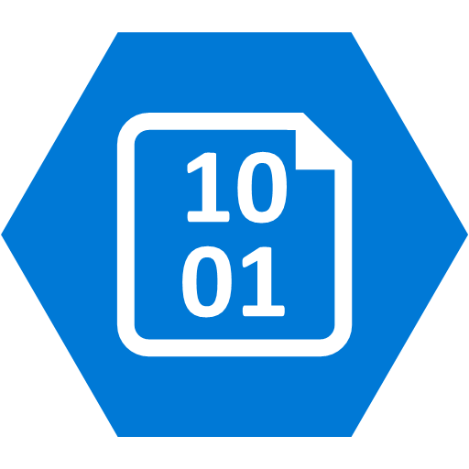







Platform Services
Security & Management
Compute
Web and Mobile
Developer Services
Hybrid
Operations
Cloud
Services
Service
Fabric
Web Apps
API
Apps
API
Management
Visual Studio
Azure SDK
Portal
Azure AD
Connect Health
Batch
Remote App
Mobile
Apps
Logic
Apps
Notification
Hubs
Team Project
Application
Insights
Active
Directory
AD Privileged
Identity
Management
Multi-Factor
Authentication
Integration
Analytics & IoT
Data
Backup
Storage
Queues
Biztalk
Services
Automation
HDInsight
Machine
Learning
SQL
Database
SQL Data
Warehouse
Operational
Insights
Hybrid
Connections
Service
Bus
Key Vault
Data
Factory
Event
Hubs
Redis
Cache
Search
Import/Export
Store /
Marketplace
Media & CDN
Site
Recovery
Stream
Analytics
Mobile
Engagement
DocumentDB
Tables
VM Image Gallery
& VM Depot
Media
Services
Content Delivery
Network (CDN)
StorSimple
Infrastructure Services
Compute
Storage
Networking
Virtual Machines
Containers
BLOB Storage
Azure Files
Premium Storage
Virtual Network
Load Balancer
DNS
Express
Route
Traffic Manager
VPN Gateway
Application Gateway
Datacenter Infrastructure (24 Regions, 22 Online)

Slide 3
Azure Virtual Networks
A protected private virtual network in cloud
Extend enterprise networks into Azure
Cross-premises connectivity

Slide 4






Cross-premises Connectivity
Site-to-site
Create a secure connection between your on-premises site and your virtual network
Point-to-site
Create a secure connection via VPN to your virtual network
ExpressRouteTM
Create a private connection between Azure data centers and infrastructures on your premises or in a co-location environment.
Connect at an ExpressRoute location (Exchange Provider facility)
Direct connect via a Network Service Provider
Microsoft Azure

Slide 5
Identity as the control plane
Simple connection
Self-service
Single sign on
Windows Server
Active Directory
Username
•••••••••••
Other Directories
SaaS
Azure
Public
cloud
Office 365
On-premises
Cloud
Microsoft Azure Active Directory

Slide 6


Your Directory on the cloud
HR Apps
Connect and Sync on-premises directories with Azure.
Azure Active Directory Connect and Connect Health
MIM
*
*
PowerShell
Microsoft Azure
Active Directory
SQL (ODBC)
LDAP v3
Web Services ( SOAP, JAVA, REST)
Other Directories

Slide 7
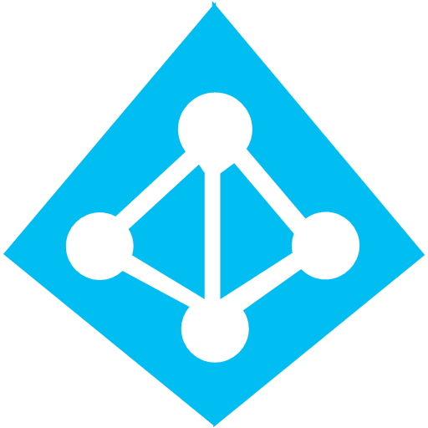

Delivering a seamless user authentication experience
Active Directory
Microsoft Azure
Identity Synchronization with password (hash) sync
User attributes are synchronized using Identity Synchronization services including a password hash, Authentication is completed against Azure Active Directory
Identity Synchronization
Microsoft Azure
User attributes are synchronized using Identity Synchronization tools, Authentication is passed back through federation and completed against Windows Server Active Directory
AD FS

Slide 8
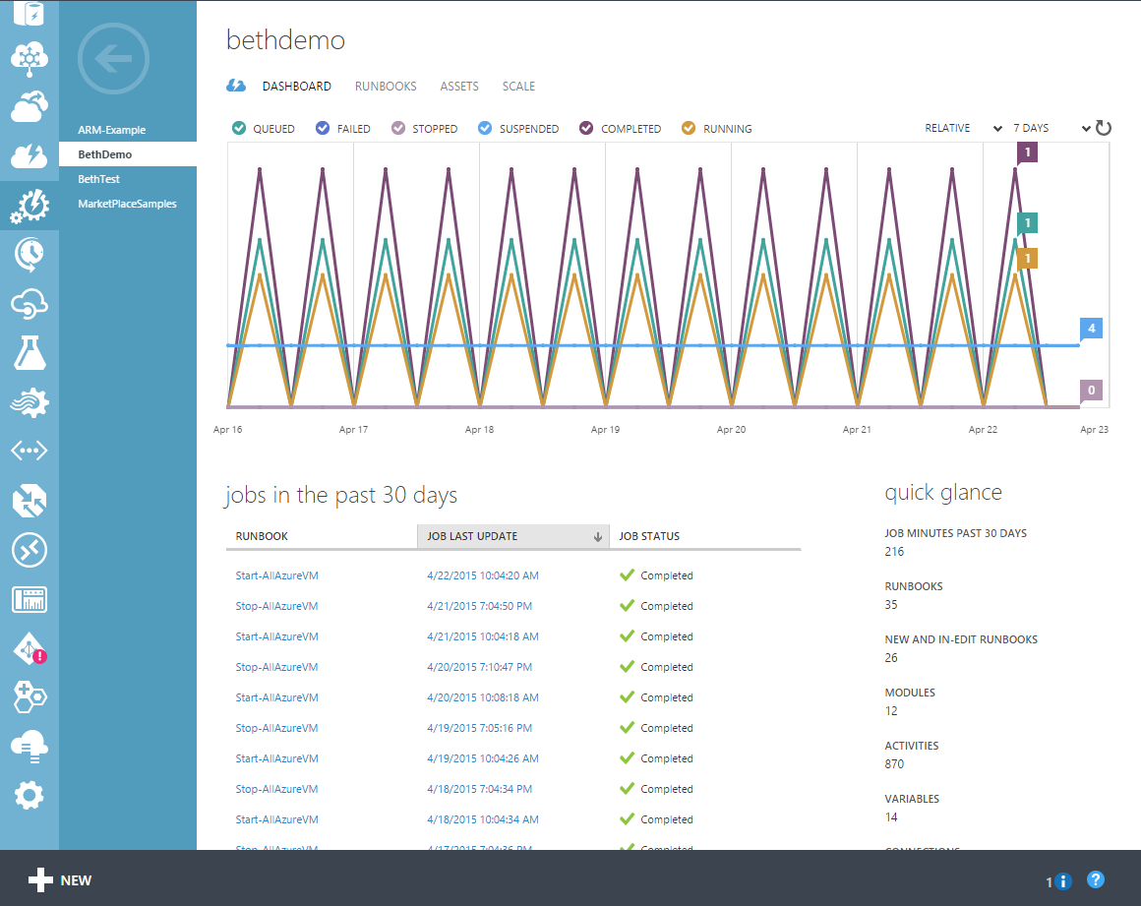
Automation in the portal
Features
PowerShell runbook editor
Test & publish runbooks
Monitor & troubleshoot production jobs
Runbook Gallery
Resources
Runbooks
Jobs
Modules
Schedules
Certificates, variables, credentials, connections

Slide 9
Automation Concepts
Core Automation resources
Runbooks: textual and graphical
Runbook Jobs
Automation resources used by runbooks
Runbook triggers: schedules, and webhooks
Modules, Certificates, Connections, Variables, Credentials
DSC Configurations (coming soon to the portal!)
Hybrid Runbook Workers

Slide 10



Integrate on-prem and cloud
Source Control
ARM Template
Site Content
Azure
Website
Azure Automation
On-premises data center
Hybrid runbook worker
On-premises VM

